Slide 1

COMP 8547
Advance computing concepts
PROJECT : SEARCH ENGINE IN JAVA
INSTRUCTOR : Mahdi Firoozjaei
PRESENTED BY :URVISH PATEL(110072574)
RAJKUMAR PATEL(110060973)
JAY PATEL(110073084)
MAYANK PATEL(110072211)

Slide 2
Agenda
Introduction
Working of a Search Engine
Tools And Documents
Functionalities
System flow
Concepts Used
Team member roles
Conclusion
Future Work

Slide 3
Introduction
A search engine is a piece of software that allows users to search the internet using textual information they've entered. The search results can be text, a webpage, an image, or something else entirely.
Spiders or crawlers are automatic software used by search engines to browse the web, following links from page to page and site to site. The results of the search were utilized to create a constructible web index.
Famous Search engines: Google, DuckDuckGo

Slide 4
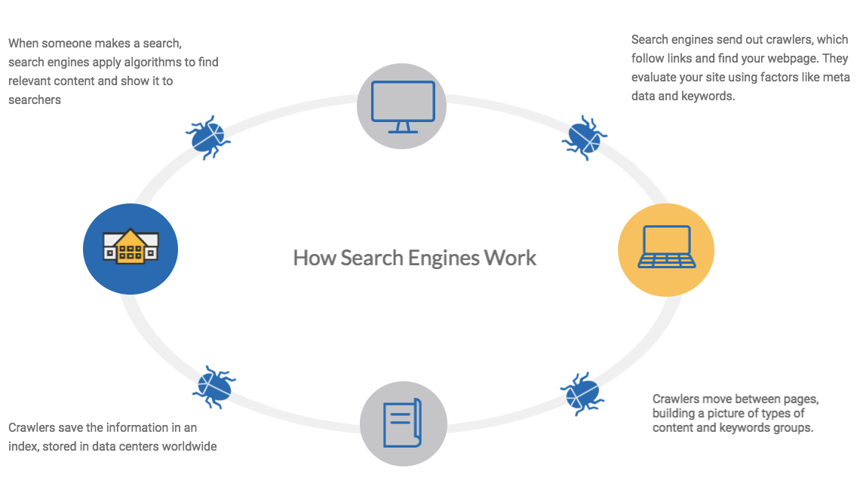
Working of a Search Engine:

Slide 5
TOOLS AND DOCUMENTS:
Eclipse IDE
Jsoup library
Reference Data from- www.youtube .com
For communication- Google Meet,Teams

Slide 6
Functionalities
Web Crawler
Pattern matching
HTML to Text
Word suggestion
Page Ranking

Slide 7
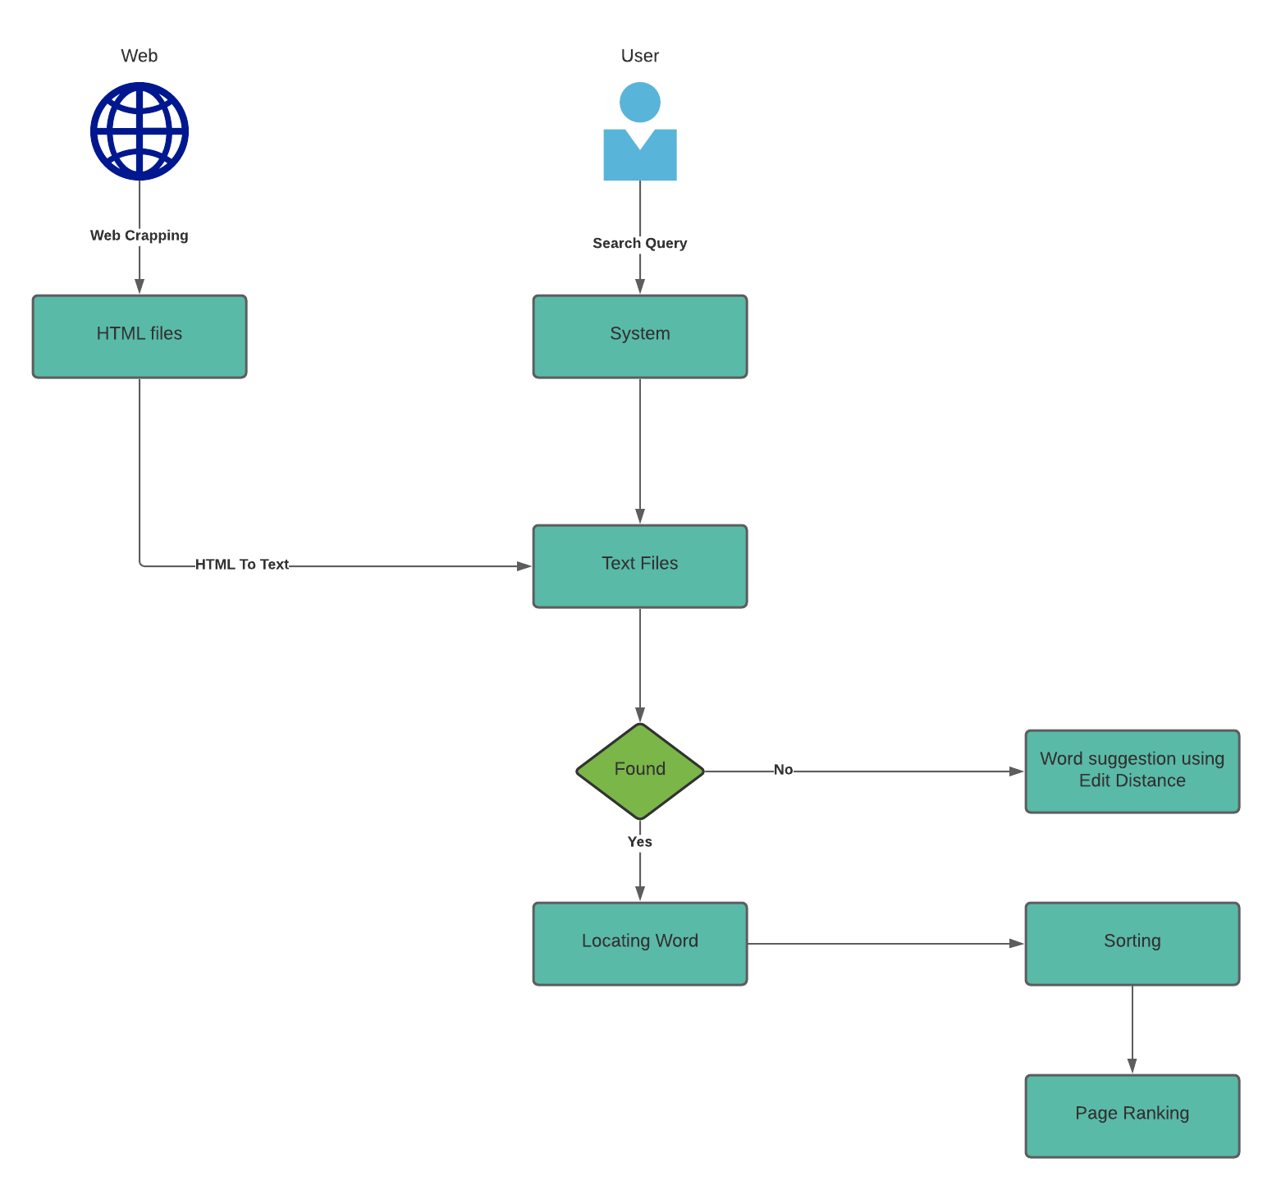
System Flow:

Slide 8





Concept used:
Boyre Moore Algorithm
Edit Distance
Sorting
Regular Expression
Hash Table

Slide 9
Team member role:
JAY PATEL
Word Suggestion
URVISH PATEL
Word search
RAJKUMAR PATEL
Web crawler
MAYANK PATEL
HTML to Text Ranking(Indexing)

Slide 10
Conclusion:
After Learning very important topics like Boyer More, Hash table, Regular expressions, sorting and Edit distance in the lectures as well as the lab, we successfully implemented search engine in JAVA by merging this all learned topics into one project.

Slide 11
Future Work:
Improve Efficiency
Update the old pages → new
Dynamic Crawler
Graphical User Interface

Slide 12


